Slide 1
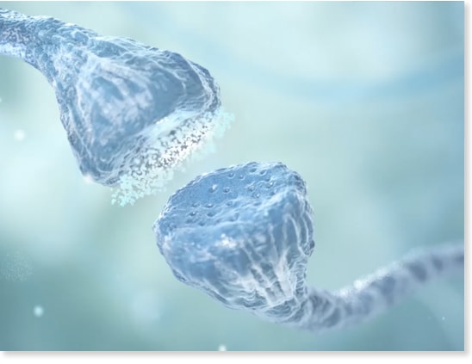
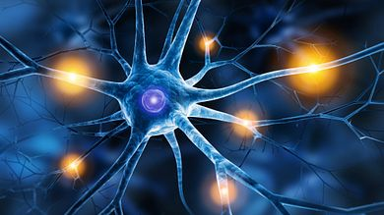
Physiology of Pain
Dr Jayasree V
Assistant Professor
Department of Physiology

Slide 2
Pain is defined as an unpleasant and emotional experience associated with or without actual tissue damage.
Pain sensation is described in many ways like sharp, pricking, electrical, dull ache, shooting, cutting, stabbing, etc.
Often it induces crying and fainting.

Slide 3
Pain is produced by real or potential injury to the body.
Often it is expressed in terms of injury.

Slide 4
Pain may be acute or chronic.
Acute pain is a sharp pain of short duration with easily identified cause.
Often it is localized in a small area before spreading to neighboring areas.
Usually it is treated by medications.
Chronic pain is the intermittent or constant pain with different intensities.
It lasts for longer periods.

Slide 5
BENEFITS OF PAIN SENSATION
Pain is an important sensory symptom.
Pain gives warning signal about the existence of a problem or threat. It also creates awareness of injury.
Pain prevents further damage by causing reflex withdrawal of the body from the source of injury.
Pain forces the person to rest or to minimize the activities thus enabling rapid healing of injured part.
Pain urges the person to take required treatment to prevent major damage.

Slide 6
COMPONENTS OF PAIN SENSATION
Pain sensation has two components:
1. Fast pain
2. Slow pain.
Fast pain is the first sensation whenever a pain stimulus is applied.
It is experienced as a bright, sharp and localized pain sensation.
Fast pain is followed by the slow pain, which is experienced as a dull, diffused and unpleasant pain.

Slide 7
Receptors for both the components of pain are same, i.e. the free nerve endings.
But, afferent nerve fibers are different.
Fast pain sensation is carried by Aδ fibers and slow pain sensation is carried by C type of nerve fibers.

Slide 8
PATHWAYS OF PAIN SENSATION
Pain sensation from various parts of body is carried to brain by different pathways which are:
1. Pathway from skin and deeper structures
2. Pathway from face
3. Pathway from viscera
4. Pathway from pelvic region.

Slide 9
FROM SKIN AND DEEPER STRUCTURES
Receptors
Receptors of pain sensation are the free nerve endings, which are distributed throughout the body.

Slide 10
First Order Neurons
First order neurons are the cells in posterior nerve root ganglia, which receive the impulses of pain sensation from pain receptors through their dendrites.
These impulses are transmitted to spinal cord through the axons of these neurons.
Pain receptors
P N R G Cells

Slide 11
Fast pain fibers
Fast pain sensation is carried by Aδ type afferent fibers which synapse with neurons of marginal nucleus in the posterior gray horn.
Slow pain fibers
Slow pain sensation is carried by C type afferent fibers, which synapse with neurons of substantia gelatinosa of Rolando in the posterior gray horn

Slide 12
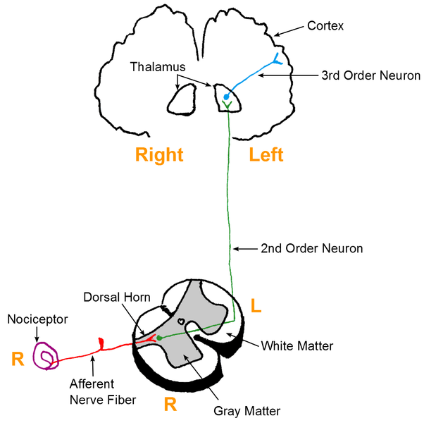
Second Order Neurons
Neurons of marginal nucleus and substantia gelatinosa of Rolando form the second order neurons.
Fibers from these neurons ascend in the form of the lateral spinothalamic tract.

Slide 13
Fast pain fibers
Fibers of fast pain arise from neurons of marginal nucleus.
Immediately after taking origin, the fibers cross the midline via anterior gray commissure, reach the lateral white column of the opposite side and ascend.
These fibers form the neospinothalamic fibers in lateral spinothalamic tract.
These nerve fibers terminate in ventral posterolateral nucleus of thalamus.
Some of the fibers terminate in ascending reticular activating system of brainstem.

Slide 14
Slow pain fibers
Fibers of slow pain, which arise from neurons of substantia gelatinosa, cross the midline and run along the fibers of fast pain as paleospinothalamic fibers in lateral spinothalamic tract.
One fifth of these fibers terminate in ventral posterolateral nucleus of thalamus.
Remaining fibers terminate in any of the following areas:
i. Nuclei of reticular formation in brainstem
ii. Tectum of midbrain
iii. Gray matter surrounding aqueduct of Sylvius.

Slide 15
Third Order Neurons
Third order neurons of pain pathway are the neurons in:
i. Thalamic nucleus
ii. Reticular formation
iii. Tectum
iv. Gray matter around aqueduct of Sylvius.
Axons from these neurons reach the sensory area of cerebral cortex.
Some fibers from reticular formation reach hypothalamus.

Slide 16
Center for Pain Sensation
Center for pain sensation is in postcentral gyrus of parietal cortex.
Fibers reaching hypothalamus are concerned with arousal mechanism due to pain stimulus.

Slide 18
2. FROM FACE
Pain sensation from face is carried by trigeminal nerve.
3. FROM VISCERA
Pain sensation from thoracic and abdominal viscera is transmitted by sympathetic (thoracolumbar) nerves.
Pain from esophagus, trachea and pharynx is carried by vagus and glossopharyngeal nerves.

Slide 19
4. FROM PELVIC REGION
Pain sensation from deeper structures of pelvic region is conveyed by sacral parasympathetic nerves.

Slide 20
VISCERAL PAIN
Pain from viscera is unpleasant. It is poorly localized.
CAUSES OF VISCERAL PAIN
1. Ischemia
Substances released during ischemic reactions such as bradykinin and proteolytic enzymes stimulate the pain receptors of viscera.
2. Chemical Stimuli
Chemical substances like acidic gastric juice, leak from ruptured ulcers into peritoneal cavity and produce pain.
3. Spasm and Over distention of Hollow Organs
Spastic contraction of smooth muscles in gastrointestinal tract and other hollow organs of viscera cause pain by stimulating the free nerve endings.
Over distention of hollow organs also causes pain.

Slide 21
REFERRED PAIN
Referred pain is the pain that is perceived at a site adjacent to or away from the site of origin.
Deep pain and some visceral pain are referred to other areas.
But, superficial pain is not referred.
EXAMPLES OF REFERRED PAIN
Cardiac pain is felt at inner part of left arm and left Shoulder.
Pain in ovary is referred to umbilicus
Pain from testis is felt in abdomen
Pain in diaphragm is referred to shoulder
Pain in gallbladder is referred to epigastric region
Renal pain is referred to loin.

Slide 22
Dermatomal Rule
According to dermatomal rule, pain is referred to a structure, which is developed from the same dermatome from which the pain producing structure is developed.

Slide 23
A dermatome includes all the structures or parts of the body, which are innervated by afferent nerve fibers of one dorsal root.
For example, the heart and inner aspect of left arm originate from the same dermatome.
So, the pain in heart is referred to left arm.

Slide 25
NEUROTRANSMITTERS INVOLVED IN PAIN SENSATION
Glutamate and substance P are the neurotransmitters secreted by pain nerve endings.
Aδ afferent fibers, which transmit impulses of fast pain secrete glutamate.
The C type fibers, which transmit impulses of slow pain secrete substance P.

Slide 26
ANALGESIA SYSTEM
Analgesia system means the pain control system.
Body has its own analgesia system in brain, which provides a short term relief from pain.
It is also called endogenous analgesic system.

Slide 27
Analgesia system has got its own pathway through which it blocks the synaptic transmission of pain sensation in spinal cord and thus attenuates the experience of pain.
In fact analgesic drugs such as opioids act through this system and provide a controlled pain relief.

Slide 28
ANALGESIC PATHWAY
Analgesic pathway that interferes with pain transmission is often considered as descending pain pathway, the ascending pain pathway being the afferent fibers that transmit pain sensation to the brain.

Slide 30
Role of Analgesic Pathway in Inhibiting Pain Transmission
1. Fibers of analgesic pathway arise from frontal lobe of cerebral cortex and hypothalamus
2. These fibers terminate in the gray matter surrounding the third ventricle and aqueduct of Sylvius (periaqueductal gray matter)

Slide 31
3. Fibers from here descend down to brainstem and terminate on:
i. Nucleus raphe magnus, situated in reticular formation of lower pons and upper medulla
ii. Nucleus reticularis, paragigantocellularis situated in medulla

Slide 32
4. Fibers from these reticular nuclei descend through lateral white column of spinal cord and reach the synapses of the neurons in afferent pain pathway situated in anterior gray horn.
Synapses of the afferent pain pathway are between:
i. Aδ type afferent fibers and neurons of marginal nucleus
ii. C type afferent fibers and neurons of substantia gelatinosa of Rolando.

Slide 33
5. At synaptic level, analgesic fibers release neurotransmitters and inhibit the pain transmission before being relayed to brain.

Slide 34
Neurotransmitters of Analgesic Pathway
Neurotransmitters released by the fibers of analgesic pathway are serotonin and opiate receptor substances namely enkephalin, dynorphin and endorphin.

Slide 35
GATE CONTROL THEORY
Psychologist Ronald Melzack and the anatomist Patrick Wall proposed the gate control theory for pain in 1965 to explain the pain suppression.

Slide 36
According to them, the pain stimuli transmitted by afferent pain fibers are blocked by gate mechanism located at the posterior gray horn of spinal cord.
If the gate is opened, pain is felt. If the gate is closed, pain is suppressed.

